Slide 1
Regional Course on Statistical Business Registers
Session 7: SBR Maturity Model (continued)
● Dimension 4: Coverage of an SBR ● Dimension 5: Use of an SBR

Slide 2
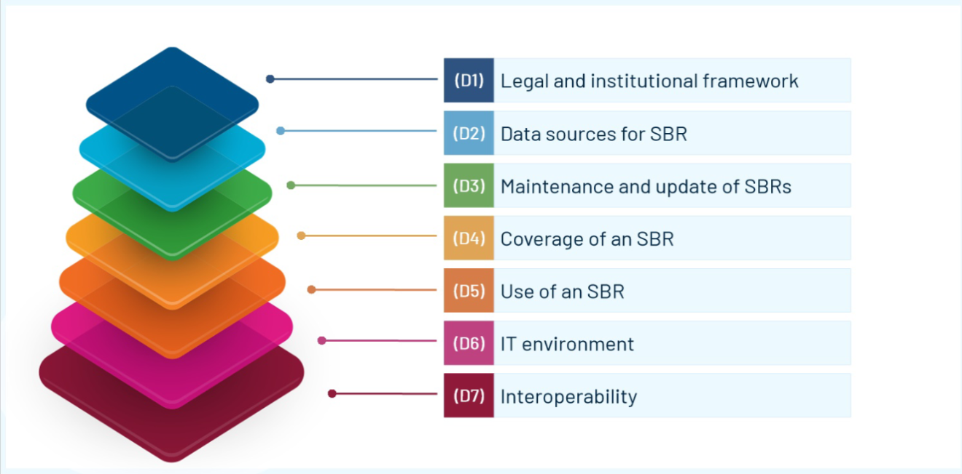

Seven dimensions

Slide 3

Dimension 4: Coverage of an SBR
There are three key aspects:
• Completeness is the extent to which the SBR includes all institutional units within the 2008 SNA production boundary
• Coverage is the proportion of total national economic production that the units represent.
• Content is the set of characteristics (e.g., types of units, institutional sector, size, location and registration status) of the units contained in the SBR.
Notes:
This dimension of the maturity model refers to the coverage of SBRs.

Slide 4
Coverage of an SBR
In principle, an SBR should record all institutional units in the national economy that are engaged in productive economic activities; i.e., activities contributing to the gross domestic product (GDP). Thus, NSOs should aim to cover as much national production as possible in their SBRs by including all types of institutional units engaged in production.
However, where complete coverage is not easily attainable in practice, and a more realistic aim for coverage can be taken.

Slide 5
Coverage of an SBR
One particular issue is coverage of the informal economy, which is highly diversified and for which no administrative data exist.
It is usually not recommended to focus on coverage of the informal economy in early stages of SBR development. However, in certain countries – particularly developing and emerging economies – the informal economy is important, and the collection of economic data about it is a priority.
Notes:
In such cases, it is vital to consider to what extent, if at all, the SBR will cover the informal sector and how the economic production of those enterprises not covered by the SBR can be measured or estimated

Slide 6
Coverage of an SBR
In general, groups of units should not be omitted without an assessment of their economic importance. SBRs should aim to record, at a minimum, all active economic units in the formal economy that are engaged in economic activities contributing to the gross domestic product (GDP)

Slide 7
Coverage of an SBR
In general, when first establishing an SBR, the corporations sector is the focus, as it is the most easily covered.
The inclusion of the government sector, non-profit institutions and the household’s sectors provide more complete coverage.

Slide 8
Coverage of an SBR
List of variables that should be included in the SBR using the following groupings:
Identification and contact;
Demographic;
Economic/stratification;
Links and external references.

Slide 9
Coverage of an SBR
The coverage of the SBR highly depends on the coverage of the data sources used to update the SBR, and also on the broader legal framework governing the SBR (for example, if it is compulsory for businesses to register and whether the NSO can access administrative data or not). This dimension, therefore, is very interlinked with other dimensions of the maturity model.

Slide 10
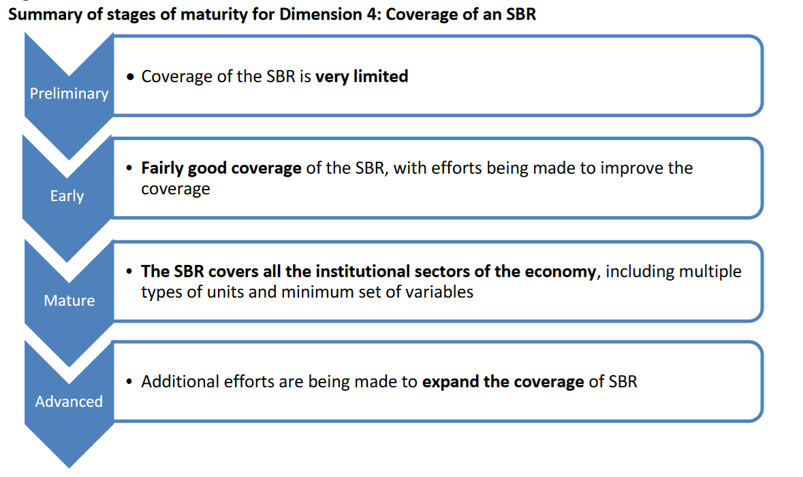
Notes:
Preliminary stage The coverage of the SBR is very limited in terms of institutional sectors and the set of characteristics of the units in the SBR. The coverage of the units in the SBR in terms of their contribution to total national economic production is also very limited. It is difficult to make an assessment of the coverage of the SBR since the information available is limited.
Early stage There is a fairly good coverage of some institutional sectors of the economy and the formal sector. Efforts are being made to assess sources and methods to improve the sectoral coverage. In terms of the characteristics of the units, there is a systematic effort to include the minimum characteristics, such as identification and contact information, demography, and economic/stratification variables. The type of units in the SBR is limited and only covers the types of units of the source data. There is not systematic effort to extend and interlink types of statistical units in the SBR.The coverage of the units in the SBR represent a good proportion of the total national economic production.
Mature All the institutional sectors of the economy are included in the SBR. The SBR include multiple types of units (e.g., legal units, establishment, local units, kind of activity units,
enterprises, or enterprise groups) and the links between them. The characteristics of the units in the SBR contain variables from the following groups: identification and
contact information; demography; economic/stratification variables; links and external references. The coverage of the units in the SBR is a significant proportion of the total national economic production.
Advanced stage
This stage includes additional efforts to expand the coverage of SBR. These efforts may include:
• the inclusion of the informal sector in the SBR if it is relevant in the country;
• The inclusion of geospatial information in the SBR to allow for spatial analyses;
• The link with global identifiers such as the LEI from GLEIF. When regional identifiers are available,
they are included in the SBR as well;
• Additional variables are included in the SBR (or can be linked to the SBR) that can support
thematic analysis such as digitalization, etc.)

Slide 11

Seven dimensions

Slide 12
Dimension 5: Use of an SBR
This dimension of the maturity model refers to the use of the SBR.
As the SBR develops, it lends itself to a wider range of uses by users internal to the NSO as well as by external users.

Slide 13
Use of an SBR
Considerations for use
Quality
Confidentiality
Notes:
This dimension includes elements of quality of the SBR, as the quality of the SBR influences how broadly user needs can be met.
The use of the SBR in statistical processes will probably depend on the stage of maturity of the other SBR dimensions.
Confidentiality is also a key consideration.

Slide 14
Use of an SBR
Internal uses
Survey frames
Survey estimation
Survey response and provider burden measure

Slide 15
Use of an SBR
External uses
Business demography
List releases of business characteristics
Micro data linking outputs
Aggregate data
Anonymised unit record data
International registers / exchange

Slide 16
Use of an SBR
As the SBR matures, its roles expand for example from being solely in support of different surveys to provide the populations of statistical units with links to administrative units at fixed points in time for specific reference periods, enabling the production of consistent and coordinated business statistics.

Slide 17
Use of an SBR
As the SBR matures, it is used as the basis for the compilation of business demography and other statistics based directly on the SBR.
Finally, as the SBR matures, it is used as the basis for micro-data linked, for data exchange and contributes to the development of international regional group registers.

Slide 18
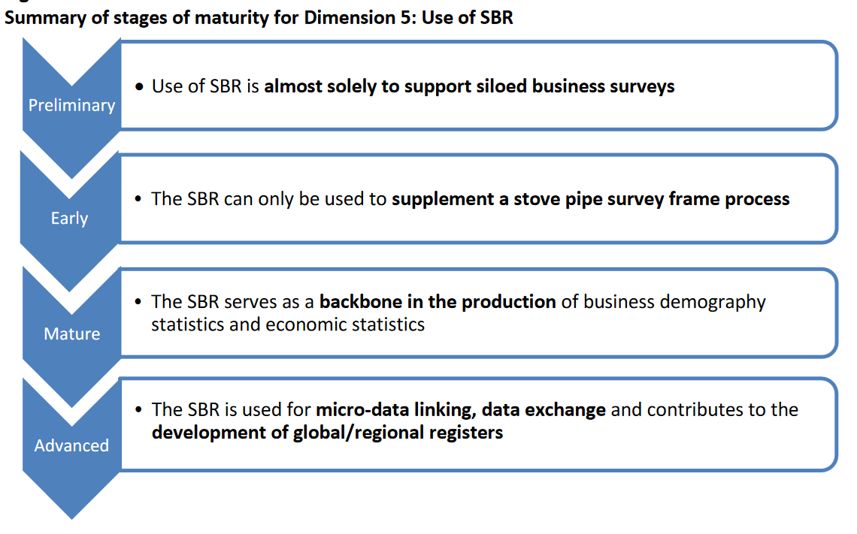
Notes:
Preliminary stage
In this stage, the use of the SBR is almost solely to support siloed business surveys. There is no attempt to provide a common frame for the production of consistent and coordinated business statistics.
Early stage
The SBR can only be used to supplement a stove pipe survey frame process. This may be because administrative sources are unable to be linked using a unique identifier, or because the input sources are not mature leading to coverage issues or double counting of units in the SBR. The users of the SBR have limited involvement in the SBR development and maintenance.
Mature stage
The SBR is used to create a snapshot/frozen frame from which all survey frames are drawn using the
standardized economic unit model and unique identifiers.
The SBR is also used to create and publish business demography statistics available to all users.
The SBR serves as a backbone in the production of economic statistics, effectively taking multiple roles in
the preparation and coordination of surveys, as a source of information for statistical analysis of the
Business population and its demography, to link administrative data, and for the identification and construction of statistical units.
Advanced stage
This stage is characterized by expanded uses of SBR, such as:
• micro-data linking
• data exchange and
• contributing to the development of international or regional group registers.
In the advanced stage, anonymized unit record data may also be released to researchers in line with
legislation and the confidentiality principle of official statistics.

Slide 19
Thank you!

